Slide 1
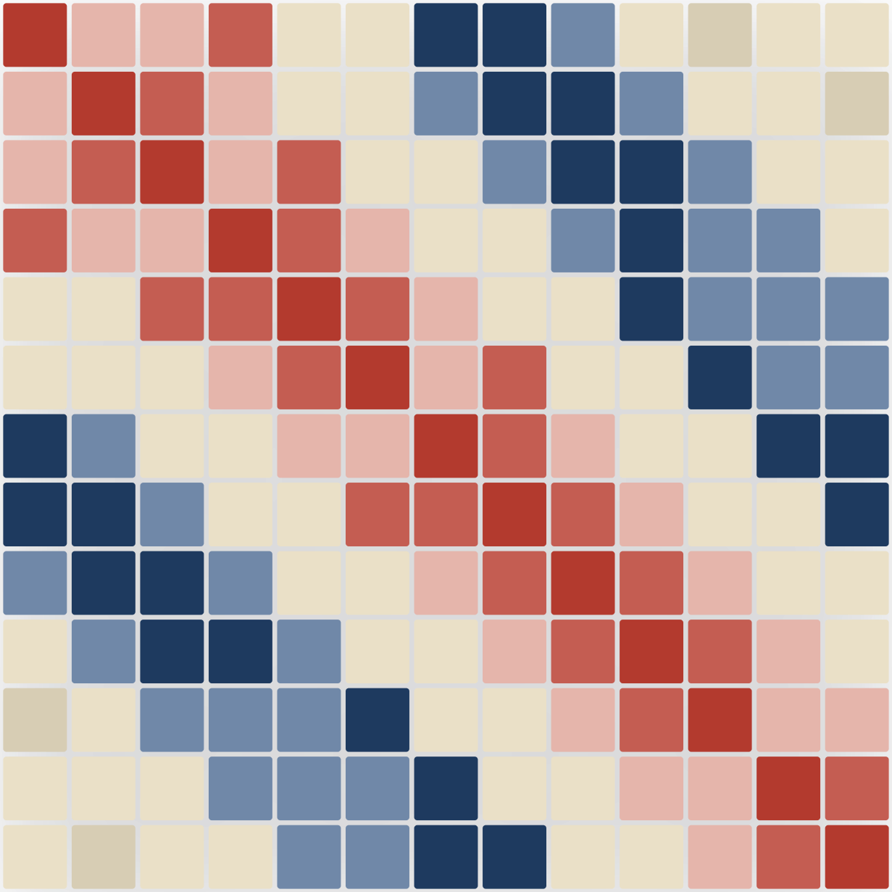
01
FINAL PROJECT · STATISTICS II
CORRELATION MATRIX · CICIDS 2017
Statistical Analysis of CICIDS 2017 Intrusion Data
Mapping normal traffic and isolating threats via multiple linear & logistic regression.
STATISTICS II · IDC 5205 · MAY 2026

Slide 2
SETUP
· RESEARCH QUESTIONS
02 / 16
Defining the baseline and the threat.
We split the question in two: first describe normal network behavior, then learn what makes an attack look different.
DATASET TERRAIN
PHASE 1 · MLR
PHASE 2 · LOGISTIC
CICIDS 2017
Establish what's normal.
Catch the culprit.
SOURCE
Canadian Institute for Cybersecurity.
TARGET
Benign traffic only.
TARGET
All traffic — benign and attack.
SCOPE
79 columns describing packet sizes, timing, TCP flags, and routing.
QUESTION
Which network flow features best predict total byte volume ( Flow.Bytes)?
QUESTION
Which features actually distinguish attack flows from benign ones?
SAMPLE
~250 rows drawn from each raw CSV across 8 days of traffic, cleaned to remove infinities and NAs.
GOAL
Identify the components that contribute to network flow in benign network configurations.
GOAL
Identify the risk factors and classify each flow as benign or attack.
STATISTICAL ANALYSIS OF CICIDS 2017 INTRUSION DATA
STATISTICS II · MAY 2026

Slide 3
EXPLORATORY
· VARIABLE GROUPING
03 / 16
The predictor sets behind each model.
After variable selection, two compact predictor sets remain — eight for the linear baseline, and thirteen for the classifier (later pruned to eleven via VIF in Logistic.R).
PHASE 1 · LINEAR REGRESSION
PHASE 2 · LOGISTIC REGRESSION
Predicting Flow.Bytes
Predicting Attack_Flag
PREDICTORS USED IN MLR_DATA.CSV
PREDICTORS USED IN GLM_DATA.CSV
min_seg_size_forward
Minimum segment size in forward direction.
Destination.Port
The targeted network port.
act_data_pkt_fwd
Count of forward packets with actual data.
Packet.Length.Variance
Variance in packet payload size.
Avg.Bwd.Segment.Size
Average size of backward data segments.
Avg.Fwd.Segment.Size
Average size of forward data segments.
Bwd.Packet.Length.Min
Minimum length of backward packets.
Avg.Bwd.Segment.Size
Average size of backward data segments.
Bwd.Packet.Length.Std
Standard deviation of backward packet lengths.
Fwd.Packet.Length.Min
Minimum length of forward packets.
PSH.Flag.Count
Count of push TCP flags.
Bwd.IAT.Total
Total inter-arrival time for backward packets.
Active.Max
Maximum time flow remained active.
Bwd.IAT.Max
Maximum inter-arrival time for backward packets.
Active.Std
Standard deviation of active time.
Init_Win_bytes_backward
Initial TCP window size (backward).
Down.Up.Ratio
Ratio of downloaded to uploaded data.
URG.Flag.Count
Count of urgent TCP flags.
PSH.Flag.Count
Count of push TCP flags.
Idle.Min
Minimum idle time between flows.
Active.Std
Standard deviation of active time.
STATISTICAL ANALYSIS OF CICIDS 2017 INTRUSION DATA
STATISTICS II · MAY 2026

Slide 4
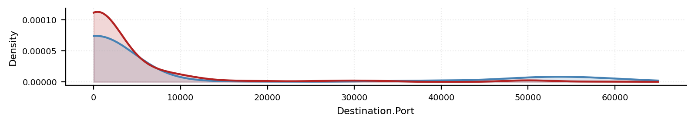
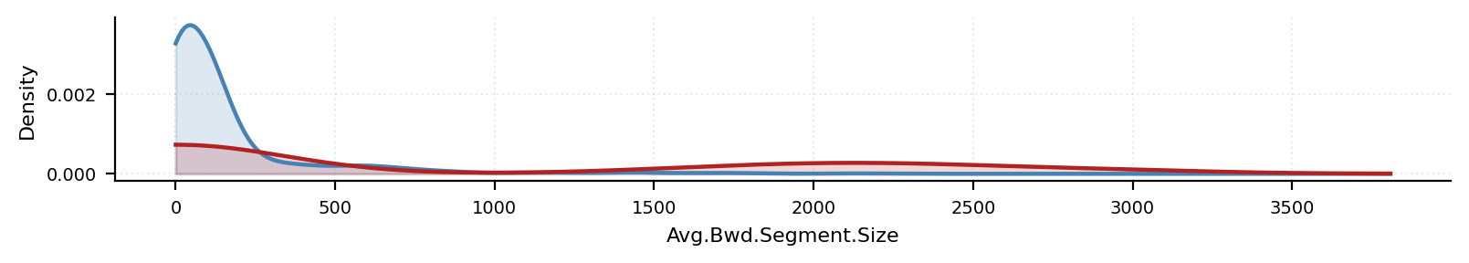
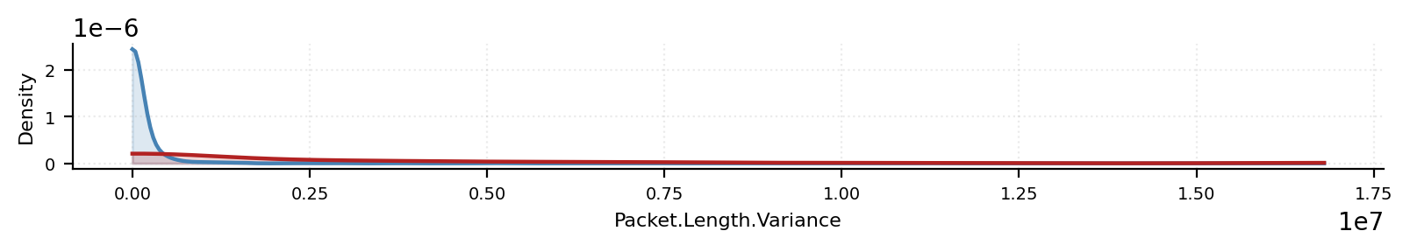
EXPLORATORY
· DESCRIPTIVE STATISTICS
04 / 16
Benign and attack distributions overlap — but their tails diverge.
Side-by-side densities of three key flow features. The bulk of each distribution sits in similar territory; the differences live in the tails and around port-range modes.
DENSITY OF DESTINATION.PORT
DENSITY OF AVG.BWD.SEGMENT.SIZE
DENSITY OF PACKET.LENGTH.VARIANCE
BENIGN ATTACK
BENIGN ATTACK
BENIGN ATTACK
VISUAL FINDING
DESCRIPTIVE STATISTICS · BENIGN VS ATTACK
Attack flows are heavily right-skewed: most cluster near zero, but a small subset reaches extreme tail values — see the mean-vs-median gap in the table (medians of 6 and 12 vs means of 854 and 2.3M). For Destination.Port, this also produces a visible second mode around the dynamic-port range; the bimodality is less visible in the other two because the extreme values are too rare and too spread out to register on a linear density plot.
VARIABLE
GROUP
N
MEAN
MEDIAN
SD
Destination.Port
Benign
1,611
8,846
80
19,146
Destination.Port
Attack
386
3,477
80
9,250
Avg.Bwd.Segment.Size
Benign
1,611
155
77
278
Avg.Bwd.Segment.Size
Attack
386
854
6
1,115
Packet.Length.Variance
Benign
1,611
119,028
811
613,694
Packet.Length.Variance
Attack
386
2,348,052
12
4,020,224
STATISTICAL ANALYSIS OF CICIDS 2017 INTRUSION DATA
STATISTICS II · MAY 2026

Slide 5
EXPLORATORY
· CATEGORICAL RISK
05 / 16
The port category anomaly — where attacks hide.
We mapped Destination.Port to the three IANA ranges, then measured how often each range carries an attack.
01
02
03
Dynamic Ports
Well-known Ports
Registered Ports
49 152 – 65 535
0 – 1 023
1 024 – 49 151
95.8% benign
82.7% benign
17.3%
55.6% benign
44.4%
4.2% attack rate — the cleanest range.
17.3% attack rate — elevated.
Nearly half of all flows here are hostile.
CHI-SQUARE INDEPENDENCE TEST
χ² = 135.83 df = 2 p < 2.22e-16
A highly significant relationship between destination-port category and attack status — the registered range is a real, statistical hot zone, not noise.
STATISTICAL ANALYSIS OF CICIDS 2017 INTRUSION DATA
STATISTICS II · MAY 2026

Slide 6
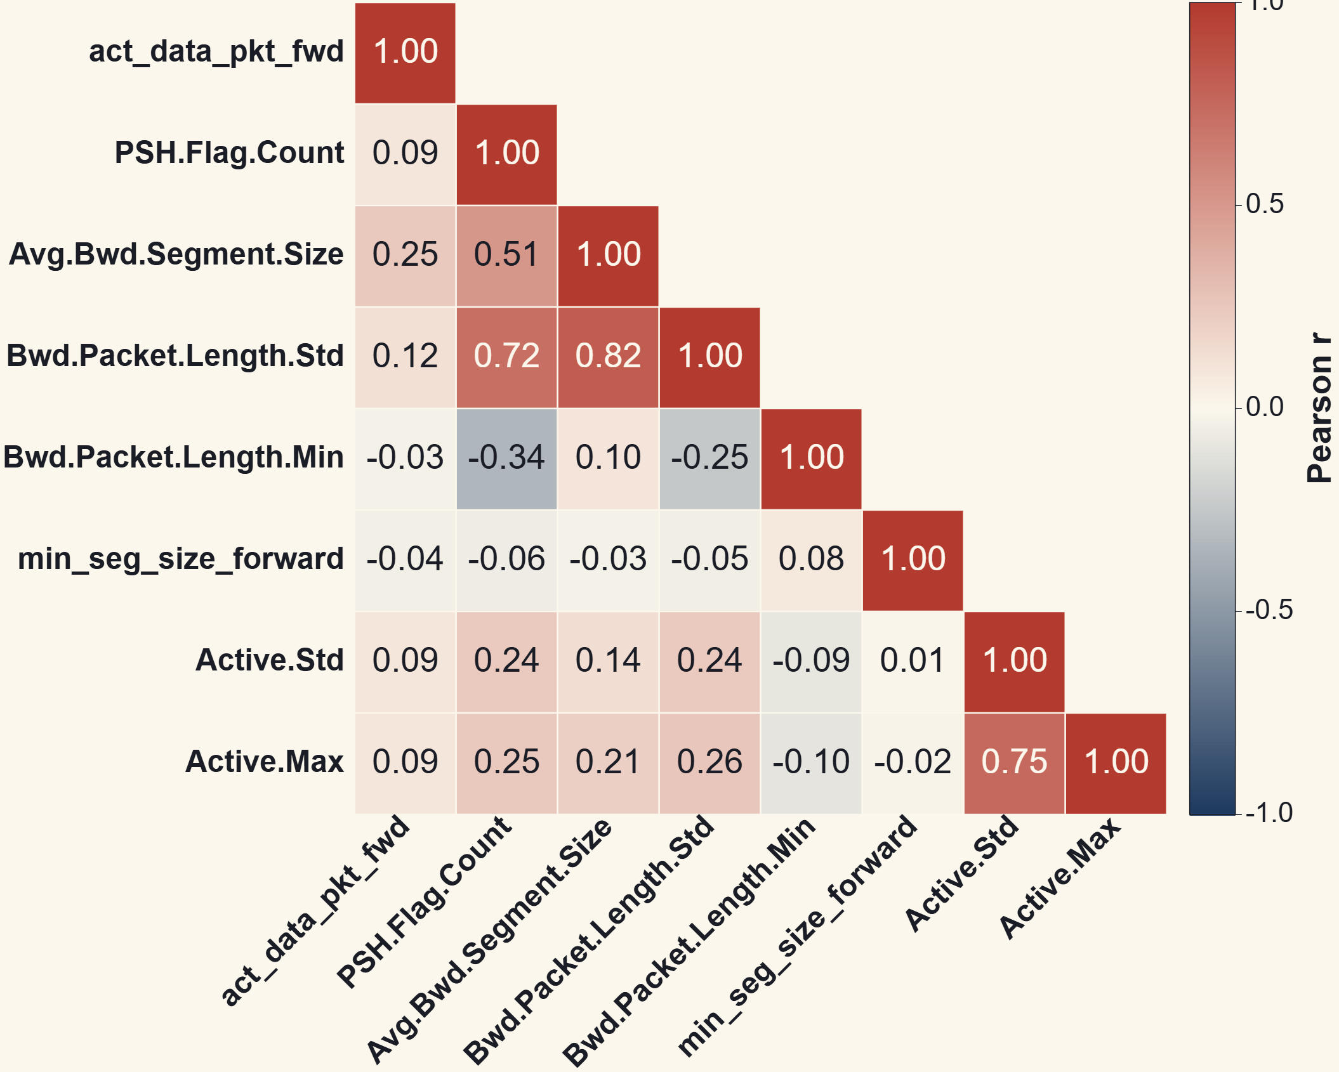
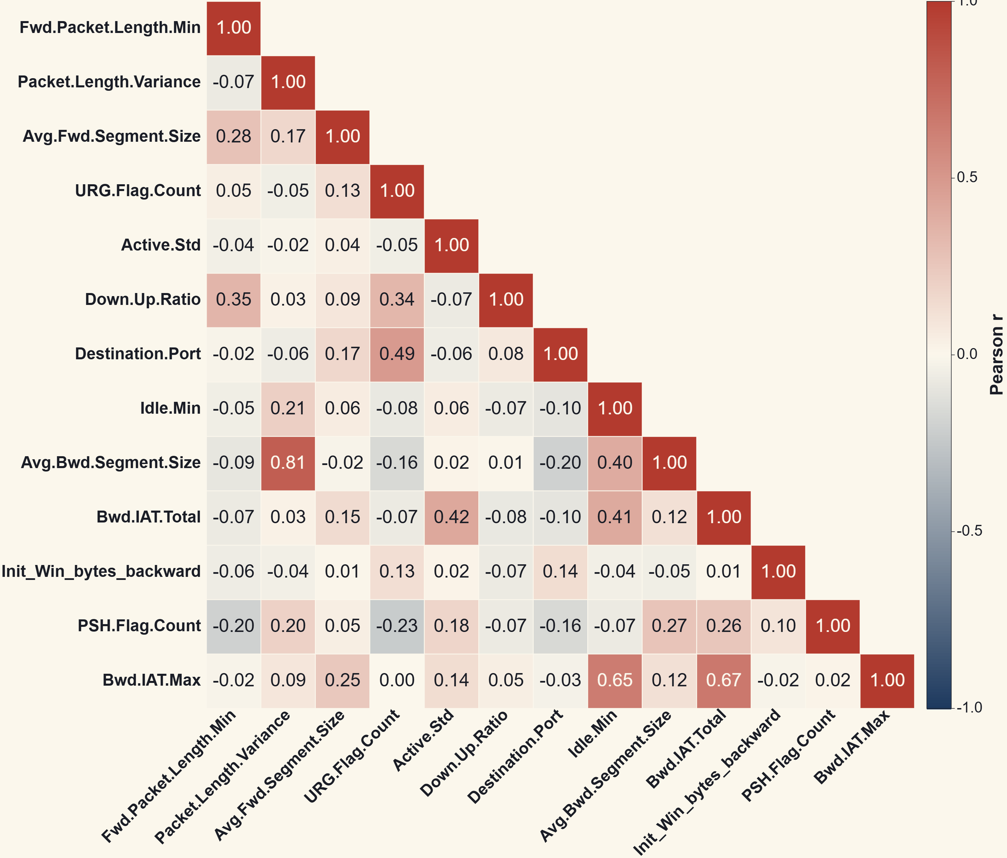
PRE-MODELING
· VARIABLE SELECTION
06 / 16
Pruning the redundant predictors.
Before either model is fit, we screen the candidates for multicollinearity. Heavily redundant variables are cut by correlation prune, then by stepwise BIC, then by iterative VIF pruning (logistic only).
RAW INPUT
NUMERIC + NON-DEGENERATE
|R| > 0.9 PRUNE
STEPWISE BIC
VIF PRUNE · LOGISTIC ONLY
79cols
see note
see note
8 / 13
11preds
CICIDS2017 flow features after CSV cleanup.
Zero-variance and non-numeric columns dropped.
Highly correlated pairs removed.
8 predictors for MLR · 13 for logistic (in glm_data.csv).
Iterative prune of VIF > 5 in Logistic.R drops 2 of the 13.
Intermediate column counts after the zero-variance drop and the |r| > 0.9 pairwise prune (chips 2 and 3) are not reported in this deck — the raw CICIDS files are held by a different team member, so the in-between counts were not re-computed locally. The pipeline endpoints (79, 8, 13, 11) are exact.
MLR PREDICTOR CORRELATIONS · PHASE 1 · 8 VARS
LOGISTIC PREDICTOR CORRELATIONS · PHASE 2 · 13 VARS (POST-BIC, PRE-VIF)
Both matrices show intense pockets of correlation (dark navy and firebrick red), particularly among packet-size and length variables. All pairs with |r| > 0.9 were pruned before stepwise BIC.
STATISTICAL ANALYSIS OF CICIDS 2017 INTRUSION DATA
STATISTICS II · MAY 2026

Slide 7
PHASE 1
· MLR SETUP
07 / 16
Modeling the shape of normal traffic.
1
MULTICOLLINEARITY CHECK · VIF
MODEL SCOPE
First-order terms only — no interactions or polynomial expansions. Keep the model interpretable.
# Variance Inflation Factor vif_values <- car::vif(m1) print (vif_values)
## act_data_pkt_fwd PSH.Flag.Count Avg.Bwd.Segment.Size
##
1.720699 2.261688 5.937063 ## Bwd.Packet.Length.Std Bwd.Packet.Length.Min min_seg_size_forward
##
6.830515 1.769534 1.038479 ## Active.Std Active.Max
##
2.406375 2.545160
2
VARIABLE SELECTION
Stepwise BIC applied to the benign-only dataset to find the leanest predictor set.
3
RESULT
8 predictors retained to model Flow.Bytes — see VIF check to the right.
⚑
VIF CAVEAT · CLASS THRESHOLD < 5
Max VIF is 6.83 (Bwd.Packet.Length.Std), with Avg.Bwd.Segment.Size at 5.94 . Both sit above the class threshold of 5, below the broader rule-of-thumb of 10. We retain them because they are substantively meaningful and dropping them noticeably hurts the fit — treated as a known caveat.
STATISTICAL ANALYSIS OF CICIDS 2017 INTRUSION DATA
STATISTICS II · MAY 2026

Slide 8
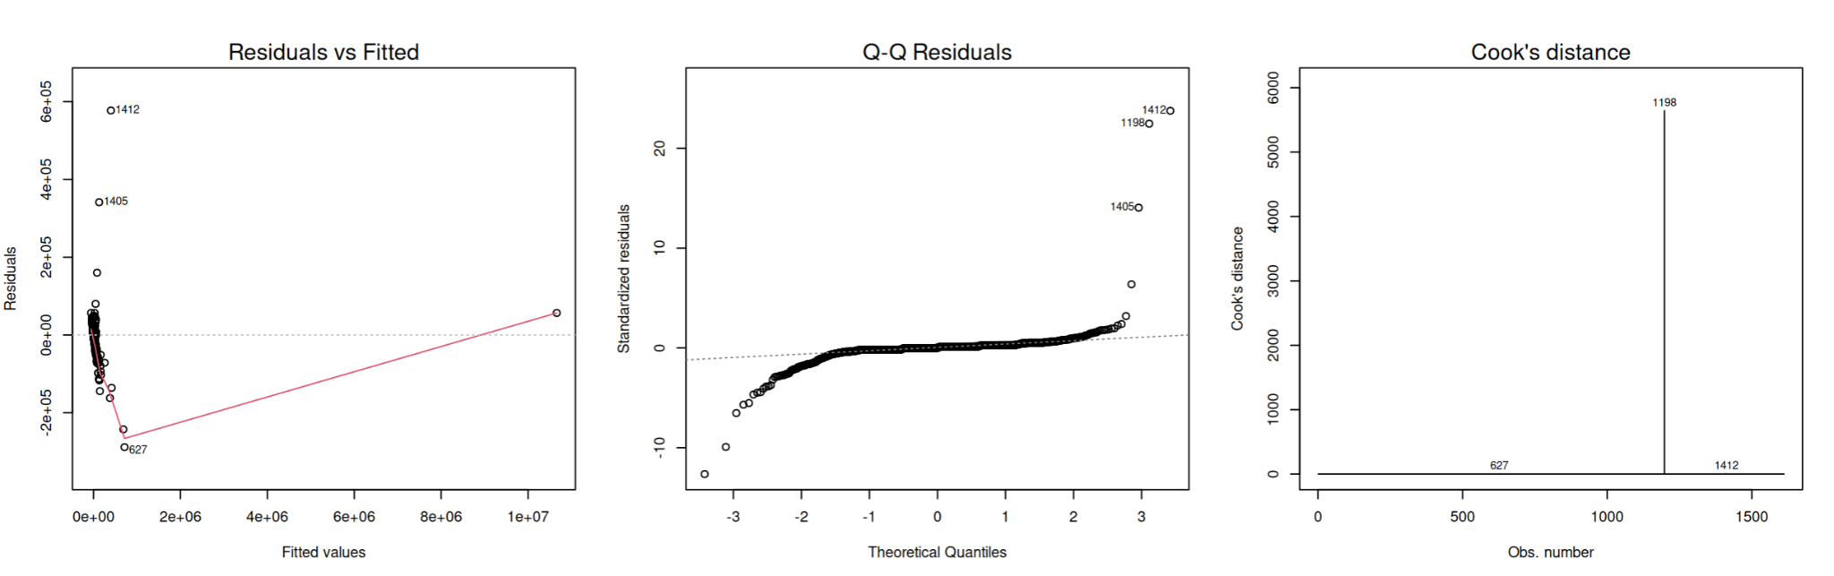
PHASE 1
· DIAGNOSTICS
08 / 16
The first fit breaks every assumption.
Before trusting any p‑value, we check residuals. The default model fails on two counts — outliers and non-normality — both visible in the diagnostic triptych.
OUTLIERS · ROW 1198
NON-NORMALITY
A single observation drives the Cook's distance plot. Row 1198 has leverage 0.99 and Cook's distance ~5,800 — artificially inflating R² to 0.99 and warping the regression plane.
The Q‑Q plot shows massive deviation in both tails — the residuals are nowhere near normal. This destabilizes every confidence interval downstream.
=== Row 1198 Outlier === > print(tab, row.names = FALSE )
Variable Row_1198 Second_Val Z_Score Times_2nd
Flow.Bytes
10716095 977134 312.81 11.0 act_data_pkt_fwd 2626 159 311.82 16.5
ACTION · NEXT SLIDE
Drop Row 1198, then re-check whether a log transform of Flow.Bytes calms the residual spread.
STATISTICAL ANALYSIS OF CICIDS 2017 INTRUSION DATA
STATISTICS II · MAY 2026

Slide 9
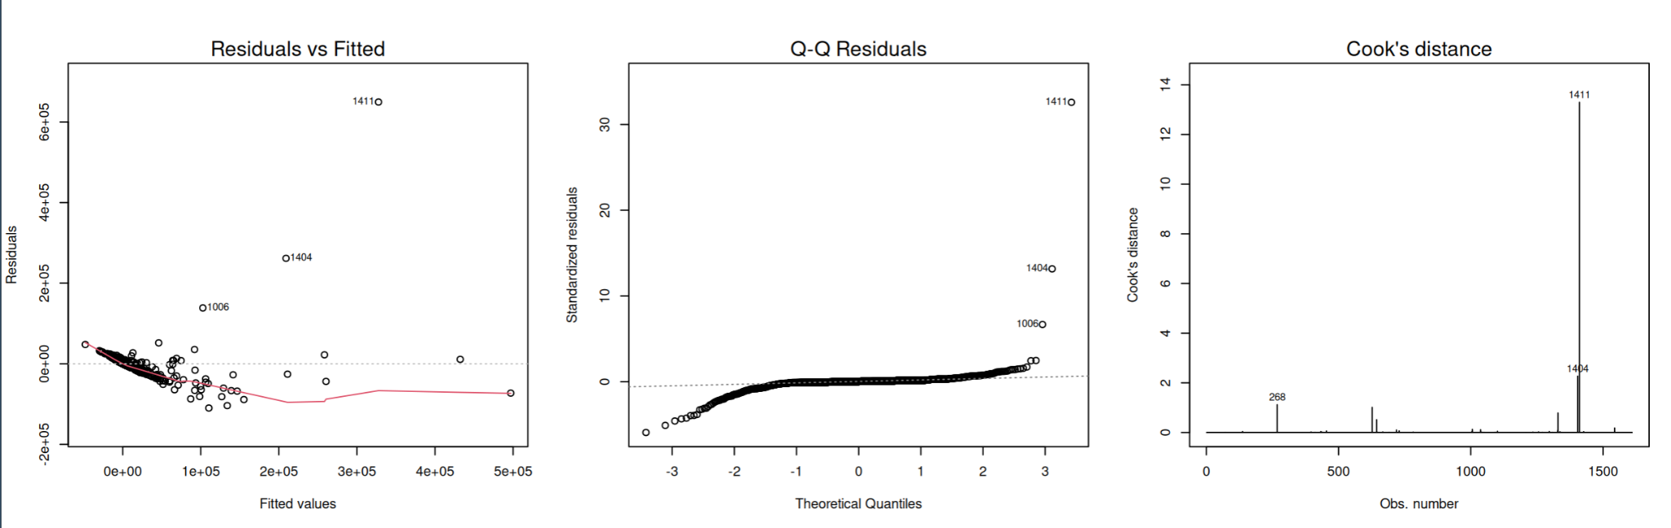
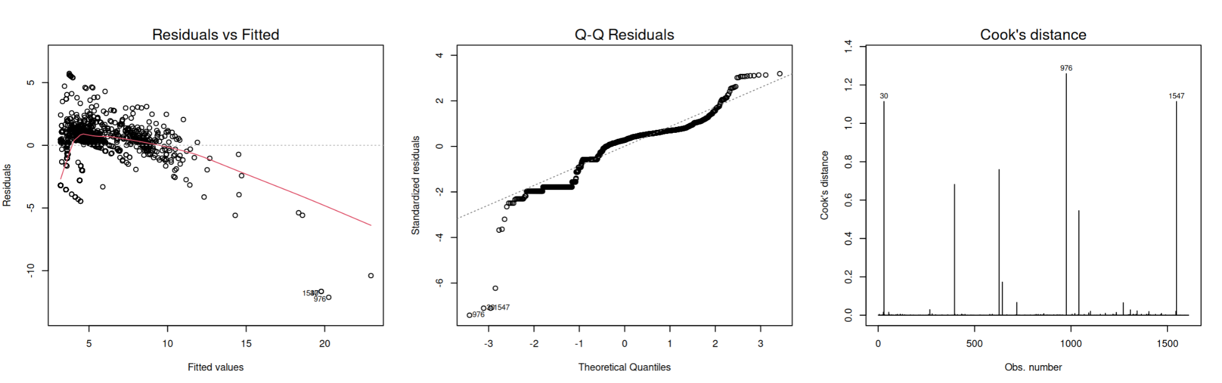
PHASE 1
· MODEL REPAIR
09 / 16
Two fixes restore the assumptions.
First the influential point comes out. Then a log1p(Flow.Bytes) transform settles the heavy tail.
1. DROPPING ROW 1198 · RAW RESPONSE
2. LOG1P(FLOW.BYTES) TRANSFORM
Cook's distance maximum drops from ~5,800 to ~14 . Residuals still cluster at low fitted values and the Q‑Q tail is heavy — a transformation is warranted.
The log transform tames the worst tail behavior and partially straightens the Q‑Q line — but residuals vs fitted still show clear curvature. The polynomial terms added on Slide 10 substantially reduce both — though some residual structure remains.
STATISTICAL ANALYSIS OF CICIDS 2017 INTRUSION DATA
STATISTICS II · MAY 2026

Slide 10
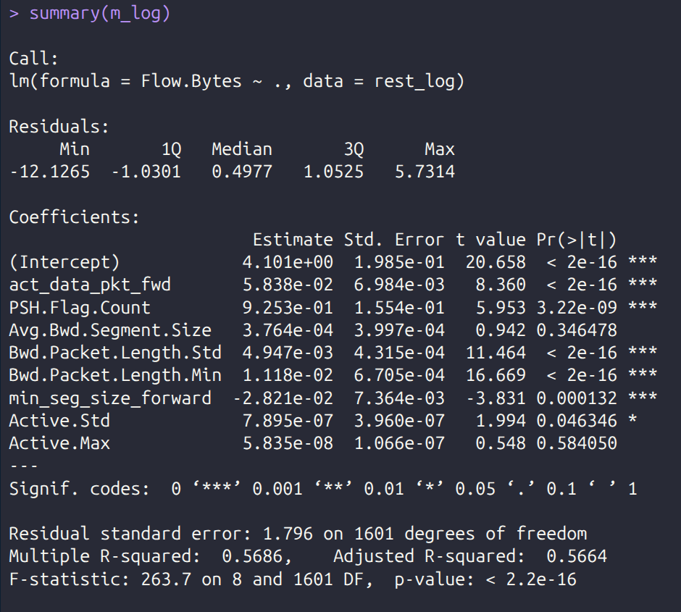
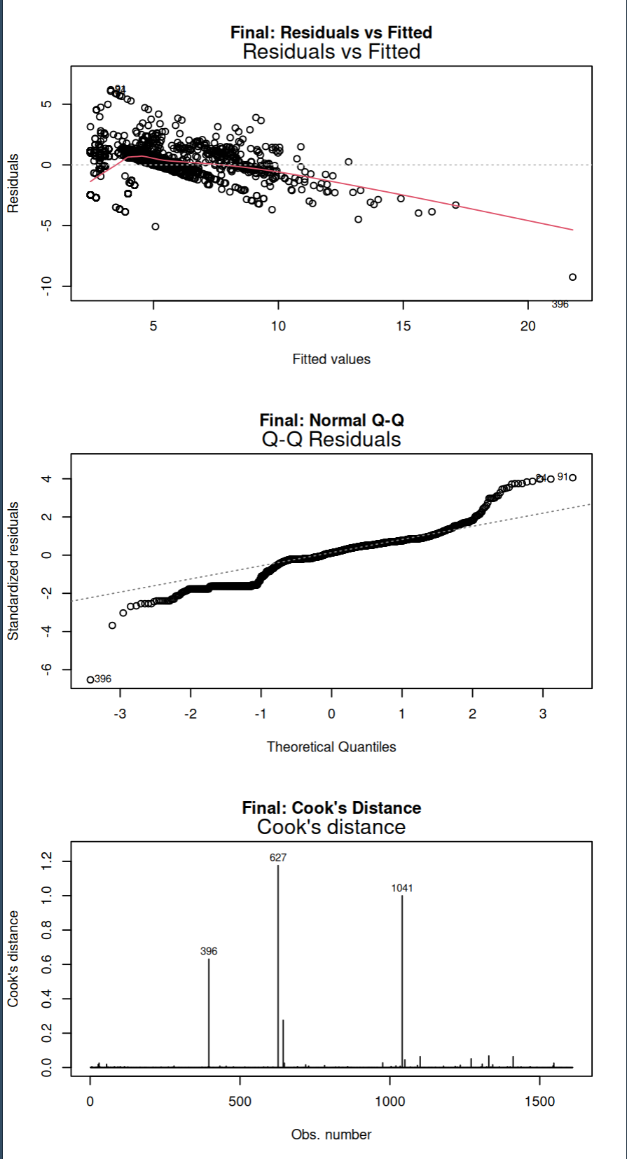
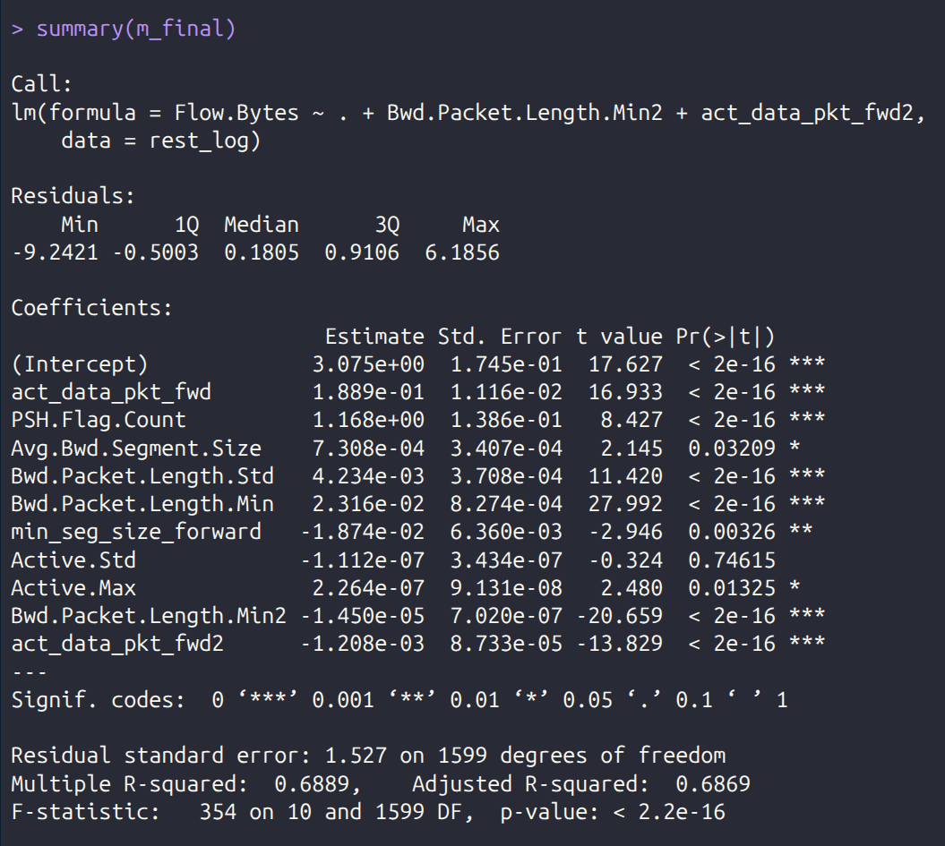
PHASE 1
· MODEL RESULTS
10 / 16
The final MLR — raw output, key takeaways.
After dropping Row 1198 and adding two polynomial terms to straighten the residual curve, two predictors revealed concave (downward-opening) relationships with log byte volume.
LINEAR · PRE-POLYNOMIAL
FINAL MODEL · DIAGNOSTIC PLOTS
KEY TAKEAWAYS
What the summary tells us.
R²
R² = 0.6889 (Adj. 0.6869) — a realistic fit after the outlier removal and polynomial terms. RSE = 1.527 on the log scale.
F
F = 354 on 10 and 1599 DF · p < 2.2e-16 — the model as a whole is overwhelmingly significant.
7/8
7 of 8 linear-term predictors significant at p < 0.05 — only Active.Std falls short.
LINEAR · FINAL MODEL · POLYNOMIAL TERMS ADDED
∩
Both quadratic terms (Bwd.Packet.Length.Min², act_data_pkt_fwd²) are highly significant with negative signs — confirming concave, peaked relationships with byte volume.
Δ
Compared to the pre-polynomial fit (R² = 0.5686): +12 percentage points of explained variance just from the two curvature terms.
After the polynomial terms, residual curvature is much milder and Cook's distance dropped from ~5,800 to ~1.2 — a substantial improvement. Some downward trend in residuals, a heavy left tail, and two points (627, 1041) with Cook's > 1 still remain. We treat this as a partial, not complete, repair.
STATISTICAL ANALYSIS OF CICIDS 2017 INTRUSION DATA
STATISTICS II · MAY 2026

Slide 11
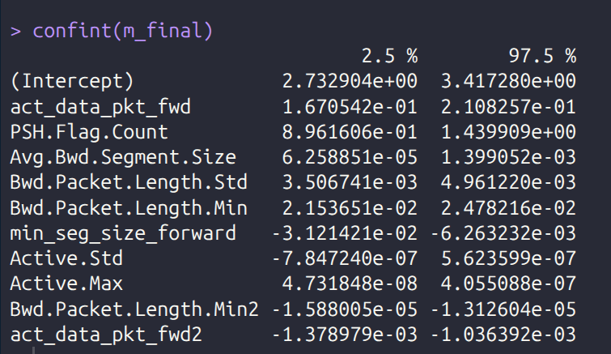
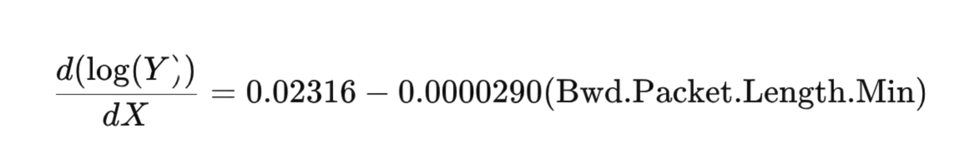
PHASE 1
· INTERPRETATION
11 / 16
What drives normal network velocity?
R-SQUARED
OVERALL SIGNIFICANCE
PREDICTORS
0.6889
F = 354
7 / 8
A realistic fit after removing the leverage outlier and adding polynomial terms.
F(10, 1599) · p < 2.2e-16
All retained predictors but Active.Std are statistically significant.
95% CONFIDENCE INTERVALS · FINAL MODEL
INTERPRETATION · THE CONCAVE EFFECT
Holding all other variables constant, the marginal effect of a one-byte increase in Bwd.Packet.Length.Min on log(Flow.Bytes) is:
At a low baseline floor, a one-byte increase raises expected throughput by ~2.32% (β = 0.02316). Due to the negative quadratic term (β = −0.0000145), this benefit diminishes 0.0029% per additional byte, peaking at 798.6 bytes . Past that threshold the marginal effect flips sign.
STATISTICAL ANALYSIS OF CICIDS 2017 INTRUSION DATA
STATISTICS II · MAY 2026

Slide 12
PHASE 2
· LOGISTIC SETUP
12 / 16
Classifying threats from the baseline.
TARGET
MODEL SCOPE
FIT
Attack_Flag
11 predictors
logit link
Binary outcome — 0 = benign, 1 = attack. Overall attack rate in the data is 19.3%.
First-order terms only. Iterative stepwise BIC, with VIF-based pruning. Max VIF: 4.37.
Binomial GLM, maximum likelihood. Convergence in < 10 iterations.
!
DIAGNOSTIC ALERT · PARTIAL SEPARATION
Active.Std, Fwd.Packet.Length.Min, and Avg.Fwd.Segment.Size were flagged for partial separation. We keep them for predictive accuracy but don't interpret their odds-ratio magnitudes — those saturate at ±100% by construction.
Train / test split discussion → moved to slide 14 (Performance), where the held-out metrics live.
STATISTICAL ANALYSIS OF CICIDS 2017 INTRUSION DATA
STATISTICS II · MAY 2026

Slide 13
PHASE 2
· FORMULATION & VARIABLES
13 / 16
A binary GLM with a logit link.
Each flow gets a probability of being an attack; the log-odds of that probability are modeled as a linear combination of the eleven retained predictors.
PREDICTOR GLOSSARY · PHASE 2 · 11 VARIABLES
GLM FORMULATION
Fwd.Packet.Length.Min
Smallest forward packet.
Destination.Port
Where traffic is going.
Y_{i} ∼ Bin(1, p_{i})
Avg.Fwd.Segment.Size
Mean forward segment size.
Idle.Min
Shortest idle period.
URG.Flag.Count
Packets with TCP URG flag set.
Avg.Bwd.Segment.Size
Mean backward segment size.
p_{i} = P(Y_{i} = 1 | X_{1i}, …, X_{pi})
Active.Std
Std-dev of active periods.
Bwd.IAT.Total
Total inter-arrival time of bwd packets.
log
p_{i}
= β₀ + β₁x_{1i} + ⋯ + β_{p}x_{pi}
Down.Up.Ratio
Download / upload ratio.
Init_Win_bytes_backward
Initial TCP receive window from server.
1 − p_{i}
PSH.Flag.Count
Packets with TCP PSH flag set.
The right side is the linear predictor (η); the left side is the log-odds of an attack. Exponentiating coefficients gives the multiplicative odds ratio per unit increase in a predictor.
STATISTICAL ANALYSIS OF CICIDS 2017 INTRUSION DATA
STATISTICS II · MAY 2026

Slide 14
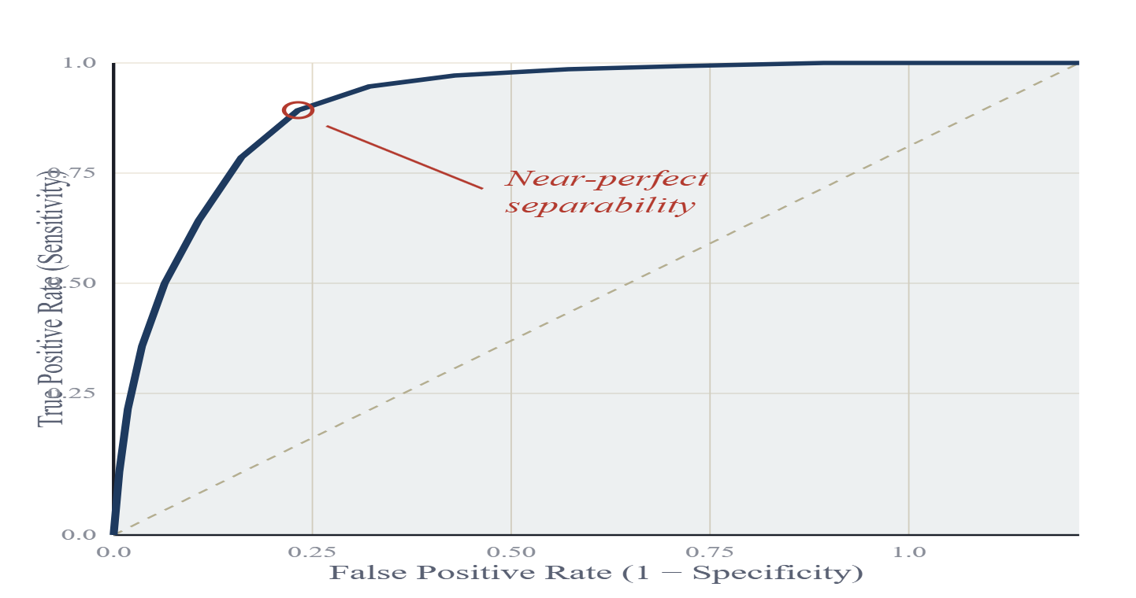
PHASE 2
· PERFORMANCE
14 / 16
The model catches attacks at near-perfect rates.
HELD-OUT TEST · 600 ROWS (30%)
TRAINING · 1,397 ROWS (70%)
TOTAL · 1,997 ROWS
Likelihood-Ratio Test · χ² = 878.25 · p = 2.94e-181 — overall model is overwhelmingly significant.
ROC CURVE · TEST SET
ACCURACY
90.3%
At Youden's-optimal cutoff — overall correct call rate on the held-out set.
SENSITIVITY
95.3%
At Youden's-optimal cutoff — of all true attacks, the model catches this many.
SPECIFICITY
89.0%
After tuning threshold via Youden's Index — correct clearance rate for benign traffic.
AUC = 0.9625
A guessing model tracks the dashed diagonal — ours hugs the top-left corner. At default 0.5 cutoff: acc 91.2%, sens 78.9%, spec 94.5%.
STATISTICAL ANALYSIS OF CICIDS 2017 INTRUSION DATA
STATISTICS II · MAY 2026

Slide 15
PHASE 2
· COEFFICIENT INTERPRETATION
15 / 16
The anatomy of an attack.
Raw summary on the left, percent-change-in-odds per 1-SD increase on the right. The signs split cleanly in two directions.
RAW R OUTPUT · SUMMARY(FINAL_MODEL)
HIGH-RISK SIGNALS · INCREASE THE ODDS
> summary(final_model)
Call:
glm(formula = Attack_Flag ~ Fwd.Packet.Length.Min + Avg.Fwd.Segment.Size +
URG.Flag.Count + Active.Std + Down.Up.Ratio + Destination.Port +
Idle.Min + Avg.Bwd.Segment.Size + Bwd.IAT.Total + Init_Win_bytes_backward +
PSH.Flag.Count, family = binomial, data = train,
control = glm.control(maxit = 100))
Coefficients:
Estimate Std. Error z value Pr(>|z|)
(Intercept) 6.347e-02 2.066e-01 0.307 0.758635
Fwd.Packet.Length.Min -1.291e-01 2.434e-02 -5.303 1.14e-07 ***
Avg.Fwd.Segment.Size -8.241e-02 1.127e-02 -7.315 2.57e-13 ***
URG.Flag.Count -8.178e+00 1.820e+00 -4.493 7.04e-06 ***
Active.Std -6.012e-01 1.005e+01 -0.060 0.952305
Down.Up.Ratio 1.520e+00 3.124e-01 4.866 1.14e-06 ***
Destination.Port -3.827e-05 8.449e-06 -4.529 5.92e-06 ***
Idle.Min 7.587e-08 1.455e-08 5.213 1.86e-07 ***
Avg.Bwd.Segment.Size 1.086e-03 2.818e-04 3.852 0.000117 ***
Bwd.IAT.Total -2.480e-08 1.328e-08 -1.867 0.061856 .
Init_Win_bytes_backward -6.841e-05 2.587e-05 -2.644 0.008188 **
PSH.Flag.Count -1.503e-02 3.333e-01 -0.045 0.964032
---
Signif. codes: 0 '***' 0.001 '**' 0.01 '*' 0.05 '.' 0.1 ' ' 1
(Dispersion parameter for binomial family taken to be 1)
Null deviance: 1336.70 on 1396 degrees of freedom
Residual deviance: 458.46 on 1385 degrees of freedom
AIC: 482.46
Number of Fisher Scoring iterations: 34
Idle.Min
+319.3%
per 1-SD increase · 95% CI [+178.4%, +562.8%] · p < 0.001
Down.Up.Ratio
+187.8%
per 1-SD increase · 95% CI [+96.2%, +325.7%] · p < 0.001
Attacks often feature prolonged idle states and asymmetric upload/download — the fingerprint of automated, one-way traffic.
PROTECTIVE SIGNALS · SEPARATION-FLAGGED
Fwd.Packet.Length.Min
−100%
unstable · separation-flagged (see Slide 12)
Avg.Fwd.Segment.Size
−100%
unstable · separation-flagged
Odds ratios saturate at −100% because attacks rarely show normal forward packet sizes. Treat as a qualitative signal only.
STATISTICAL ANALYSIS OF CICIDS 2017 INTRUSION DATA
STATISTICS II · MAY 2026

Slide 16
CONCLUSIONS
· DEFINE NORMAL, ISOLATE THE ABNORMAL
16 / 16
Define normal — isolate the abnormal.
PHASE 1 · THE BASELINE
PHASE 2 · THE ANOMALY
Multiple Linear Regression
Logistic Regression
WHAT WE LEARNED
Normal traffic volume is reasonably predictable — R² = 0.69, RSE ≈ 1.53 on the log scale — driven primarily by base segment sizes ( Avg.Bwd.Segment.Size) and active data packets.
WHAT WE LEARNED
Malicious traffic deviates sharply from the baseline. It operates disproportionately on Registered Ports (44.4% attack rate) and shows anomalous timing (Idle.Min ) and asymmetric flow ( Down.Up.Ratio).
SYSTEMIC TRAIT
The data is inherently heavy-tailed and heteroscedastic — a log transform was required before any baseline inference could be trusted.
SYSTEMIC TRAIT
These deviations let a first-order logistic model isolate attacks with 95.3% sensitivity at the Youden's-optimal cutoff (accuracy 90.3%, AUC = 0.9625).
By mathematically defining the shape of benign flow , anomalous network intrusions become statistically glaring — enabling highly sensitive automated detection.
95.3
%
ATTACK SENSITIVITY
STATISTICAL ANALYSIS OF CICIDS 2017 INTRUSION DATA
STATISTICS II · MAY 2026 · FIN

